Slide 1
Sprint 2
Classification

Slide 2
Sprint 2: Classification
Task: Predict a class from input features
Core concepts
Algorithms and models
Implementation on real dataset
Overfitting in linear classifiers
Precision/Recall trade-off
Logistic classifier
Gradient ascent
Sentiment analysis
DNA sequence classification
A. Ponsero

Slide 3
Task : Sentiment analysis
Sprint 3 - Retrieval

Slide 4


Book reviews sentiment analysis
Positive review
Review 1:
The story was amazing, the characters well developed and plot thrilling.
Classifier
Negative review
Sprint 2 - Classification

Slide 5
Algorithm: Linear classifiers
Sprint 3 - Retrieval

Slide 6
Linear Classifier
^
Y = +1
^
Output y :
Predicted class
Sentence from review
Classifier
Input x
Model
^
Y = - 1
Sprint 2 - Classification

Slide 7
Linear Classifier
Set of reviews, plotted by the number of occurrences of “Awful” and “Awesome”
#Awful
#Awsome
Notes:
So when I learn a classifier, I'm given a set of input data.
So these are sentences that have been marked to say positive or negative sentiment, and as in regression, we split it into a training set and a test set.
I feed the training set to the classifier I'm trying to learn and that algorithm is actually going to learn the weights for words.
So for example it's going to learn that good has a weight 1.0. Awesome, 1.7 Bad, -1.0. And awful, -3.3.
And then, these weights are going to be used to score every element in
the test set and evaluate how good we're doing in terms of classification.
So lets talk about what that evaluation looks like.

Slide 8
Linear Classifier
1 * #Awsome – 1.5 #Awful = 0
Set of reviews, plotted by the number of occurrences of “Awful” and “Awesome”
Negative review
#Awful
Positive review
#Awsome
Notes:
So when I learn a classifier, I'm given a set of input data.
So these are sentences that have been marked to say positive or negative sentiment, and as in regression, we split it into a training set and a test set.
I feed the training set to the classifier I'm trying to learn and that algorithm is actually going to learn the weights for words.
So for example it's going to learn that good has a weight 1.0. Awesome, 1.7 Bad, -1.0. And awful, -3.3.
And then, these weights are going to be used to score every element in
the test set and evaluate how good we're doing in terms of classification.
So lets talk about what that evaluation looks like.

Slide 9
Linear Classifier
1 * #Awsome – 1.5 #Awful = 0
Set of reviews, plotted by the number of occurrences of “Awful” and “Awesome”
Negative review
#Awful
Word | Coefficient
Awesome | 1
Awful | -1.5
Positive review
#Awsome
Notes:
So when I learn a classifier, I'm given a set of input data.
So these are sentences that have been marked to say positive or negative sentiment, and as in regression, we split it into a training set and a test set.
I feed the training set to the classifier I'm trying to learn and that algorithm is actually going to learn the weights for words.
So for example it's going to learn that good has a weight 1.0. Awesome, 1.7 Bad, -1.0. And awful, -3.3.
And then, these weights are going to be used to score every element in
the test set and evaluate how good we're doing in terms of classification.
So lets talk about what that evaluation looks like.

Slide 10
Linear Classifier
1 * #Awsome – 1.5 #Awful = 0
Set of reviews, plotted by the number of occurrences of “Awful” and “Awesome”
Negative review
#Awful
Word | Coefficient
Awesome | 1
Awful | -1.5
Positive review
#Awsome
Notes:
So when I learn a classifier, I'm given a set of input data.
So these are sentences that have been marked to say positive or negative sentiment, and as in regression, we split it into a training set and a test set.
I feed the training set to the classifier I'm trying to learn and that algorithm is actually going to learn the weights for words.
So for example it's going to learn that good has a weight 1.0. Awesome, 1.7 Bad, -1.0. And awful, -3.3.
And then, these weights are going to be used to score every element in
the test set and evaluate how good we're doing in terms of classification.
So lets talk about what that evaluation looks like.

Slide 11
Linear Classifier
A classifier will use training data to learn a weight/coefficient for each word
Word | Coefficient
Good | 1
amazing | 1.5
bad | -1
Terrible | -2.1
Disappointing | -0.5
Book, the, we, … | 0
Review X_{i} :
The story was good, the characters well developed and plot amazing. But the ending is disappointing.
Score(X_{i}) = 1 + 1.5 - 0.5 = 2
^
Score(X_{i}) >0 → y = +1
Called a linear classifier because the output is the weighted sum of inputs
Sprint 2 - Classification

Slide 12
Linear Classifier
A classifier will use training data to learn a weight/coefficient for each word
Word | Coefficient
Good | 1
amazing | 1.5
bad | -1
Terrible | -2.1
Disappointing | -0.5
Book, the, we, … | 0
Score(X_{i}) = W₀ + w₁ x_{i}[1] + … + w_{d} x_{i}[d]
Y_{i} = sign(Score(X_{i}))
Feature 1 = 1
Feature 2 = x[1] -> #awesome
Feature 3 = x[2] -> #awful
…
Feature d+1 = x[d] -> #books
Called a linear classifier because the output is the weighted sum of inputs
Sprint 2 - Classification

Slide 13
Linear Classifier
word | weight
awesome | 2.85
great | 1.7
characters | 0
bad | -1.5
Linear classifier
Score(X1) = 2.85 x (#awesome) + 1.7 x (#great) + …
>X1
“This book was awesome, and the characters were great. The writing was OK”
Y1 = Positive classification
If Score(X1) > 0 → y_{i} = +1
If score(X1) < 0 → y_{i} = -1

Slide 14
Machine learning and classification
Training dataset
x
Feature extraction
h (x)
ML model
^
y
Predicted class
review
sentence
words
w
Word weights
ML algorithm
y
review
sentiment
Quality metric
Sprint 1 - Regression

Slide 15
Algorithm: Logistic Regression
Sprint 3 - Retrieval

Slide 16
Probabilistic classification model
The book and this edition are awesome!
Definitely +1
Many classifiers models provide a degree of certainty :
P(y | x)
X=input sentence
Y = output label
The book was good and the edition was passable.
Not sure
Notes:
So when I learn a classifier, I'm given a set of input data.
So these are sentences that have been marked to say positive or negative sentiment, and as in regression, we split it into a training set and a test set.
I feed the training set to the classifier I'm trying to learn and that algorithm is actually going to learn the weights for words.
So for example it's going to learn that good has a weight 1.0. Awesome, 1.7 Bad, -1.0. And awful, -3.3.
And then, these weights are going to be used to score every element in
the test set and evaluate how good we're doing in terms of classification.
So lets talk about what that evaluation looks like.

Slide 17
Interpreting Score(X_{i})
Score(X_{i}) = W₀ + w₁ x_{i}[1] + … + w_{d} x_{i}[d]
-∞
0
+∞
Y_{i} = -1
Y_{i} = +1
Very sure !
Not sure !
Very sure !
Notes:
So when I learn a classifier, I'm given a set of input data.
So these are sentences that have been marked to say positive or negative sentiment, and as in regression, we split it into a training set and a test set.
I feed the training set to the classifier I'm trying to learn and that algorithm is actually going to learn the weights for words.
So for example it's going to learn that good has a weight 1.0. Awesome, 1.7 Bad, -1.0. And awful, -3.3.
And then, these weights are going to be used to score every element in
the test set and evaluate how good we're doing in terms of classification.
So lets talk about what that evaluation looks like.

Slide 18
Interpreting Score(X_{i})
Score(X_{i}) = W₀ + w₁ x_{i}[1] + … + w_{d} x_{i}[d]
-∞
0
+∞
Y_{i} = -1
Y_{i} = +1
Very sure !
Not sure !
Very sure !
P(y=+1|x_{i}) = 0
P(y=+1|x_{i}) = 1
Notes:
So when I learn a classifier, I'm given a set of input data.
So these are sentences that have been marked to say positive or negative sentiment, and as in regression, we split it into a training set and a test set.
I feed the training set to the classifier I'm trying to learn and that algorithm is actually going to learn the weights for words.
So for example it's going to learn that good has a weight 1.0. Awesome, 1.7 Bad, -1.0. And awful, -3.3.
And then, these weights are going to be used to score every element in
the test set and evaluate how good we're doing in terms of classification.
So lets talk about what that evaluation looks like.

Slide 19
Interpreting Score(X_{i})
Score(X_{i}) = W₀ + w₁ x_{i}[1] + … + w_{d} x_{i}[d]
-∞ < Scores < +∞
-∞
0
+∞
Y_{i} = -1
Y_{i} = +1
How do we link ?
Very sure !
Not sure !
Very sure !
P(y=+1|x_{i}) = 0
P(y=+1|x_{i}) = 0.5
P(y=+1|x_{i}) = 1
0 < Proba < 1
Notes:
So when I learn a classifier, I'm given a set of input data.
So these are sentences that have been marked to say positive or negative sentiment, and as in regression, we split it into a training set and a test set.
I feed the training set to the classifier I'm trying to learn and that algorithm is actually going to learn the weights for words.
So for example it's going to learn that good has a weight 1.0. Awesome, 1.7 Bad, -1.0. And awful, -3.3.
And then, these weights are going to be used to score every element in
the test set and evaluate how good we're doing in terms of classification.
So lets talk about what that evaluation looks like.

Slide 20
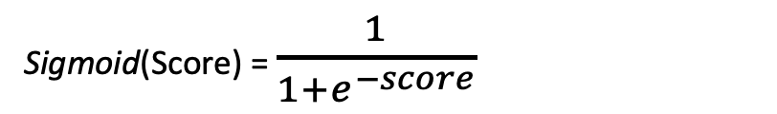
Link function: Sigmoid
Logistic regression uses a specific type of link function : the Sigmoid function
Sigmoid(Score) = $\frac{1}{1+e^{−score}}$
Sigmoid function
Score | -∞ | -2 | 0 | 2 | +∞
Sigmoid(score) | 0 | 0.12 | 0.5 | 0.88 | 1
e^{-score} | e∞=∞ |  | e⁰ = 1 |  | e ^{-∞}= 0
Notes:
So when I learn a classifier, I'm given a set of input data.
So these are sentences that have been marked to say positive or negative sentiment, and as in regression, we split it into a training set and a test set.
I feed the training set to the classifier I'm trying to learn and that algorithm is actually going to learn the weights for words.
So for example it's going to learn that good has a weight 1.0. Awesome, 1.7 Bad, -1.0. And awful, -3.3.
And then, these weights are going to be used to score every element in
the test set and evaluate how good we're doing in terms of classification.
So lets talk about what that evaluation looks like.

Slide 21
Logistic Classifier
word | weight
awesome | 2.85
great | 1.7
characters | 0
bad | -1.5
Logistic classifier
Score(X1) = 2.85 x (#awesome) + 1.7 x (#great) + …
>X1
“This book was awesome, and the characters were great. The writing was OK”
Logistic function
P(X1=positive) = 0.8
P(X1)=sigmoid (score(x))

Slide 22
Machine learning and classification
Training dataset
x
Feature extraction
h (x)
ML model
^
y
Predicted class
review
sentence
words
P(y=+1 |x,w)
w
Word weights
ML algorithm
y
review
sentiment
Quality metric
Sprint 1 - Regression

Slide 23
Algorithm: Gradient Ascent
Sprint 3 - Retrieval

Slide 24
Linear Classifier
How do we learn the coefficients ?
Learning model
Training set
Data
Validation set
Good reviews
Bad reviews
Notes:
So when I learn a classifier, I'm given a set of input data.
So these are sentences that have been marked to say positive or negative sentiment, and as in regression, we split it into a training set and a test set.
I feed the training set to the classifier I'm trying to learn and that algorithm is actually going to learn the weights for words.
So for example it's going to learn that good has a weight 1.0. Awesome, 1.7 Bad, -1.0. And awful, -3.3.
And then, these weights are going to be used to score every element in
the test set and evaluate how good we're doing in terms of classification.
So lets talk about what that evaluation looks like.

Slide 25
Linear Classifier
How do we learn the coefficients ?
word | weight
awesome | 2.85
great | 1.7
characters | 0
bad | -1.5
Learning model
Training set
Data
Accuracy
Validation set
Good reviews
Bad reviews
Notes:
So when I learn a classifier, I'm given a set of input data.
So these are sentences that have been marked to say positive or negative sentiment, and as in regression, we split it into a training set and a test set.
I feed the training set to the classifier I'm trying to learn and that algorithm is actually going to learn the weights for words.
So for example it's going to learn that good has a weight 1.0. Awesome, 1.7 Bad, -1.0. And awful, -3.3.
And then, these weights are going to be used to score every element in
the test set and evaluate how good we're doing in terms of classification.
So lets talk about what that evaluation looks like.

Slide 26
Linear Classifier
Finding the ”best” classifier = find w_{d} that maximize the likelihood function ℓ(w)
#awful
#awesome
Notes:
So when I learn a classifier, I'm given a set of input data.
So these are sentences that have been marked to say positive or negative sentiment, and as in regression, we split it into a training set and a test set.
I feed the training set to the classifier I'm trying to learn and that algorithm is actually going to learn the weights for words.
So for example it's going to learn that good has a weight 1.0. Awesome, 1.7 Bad, -1.0. And awful, -3.3.
And then, these weights are going to be used to score every element in
the test set and evaluate how good we're doing in terms of classification.
So lets talk about what that evaluation looks like.

Slide 27
Linear Classifier
Finding the ”best” classifier = find w_{d} that maximize the likelihood function ℓ(w)
#awful
#awesome
Notes:
So when I learn a classifier, I'm given a set of input data.
So these are sentences that have been marked to say positive or negative sentiment, and as in regression, we split it into a training set and a test set.
I feed the training set to the classifier I'm trying to learn and that algorithm is actually going to learn the weights for words.
So for example it's going to learn that good has a weight 1.0. Awesome, 1.7 Bad, -1.0. And awful, -3.3.
And then, these weights are going to be used to score every element in
the test set and evaluate how good we're doing in terms of classification.
So lets talk about what that evaluation looks like.

Slide 28
Linear Classifier
Finding the ”best” classifier = find w_{d} that maximize the likelihood function ℓ(w)
#awful
#awesome
Notes:
So when I learn a classifier, I'm given a set of input data.
So these are sentences that have been marked to say positive or negative sentiment, and as in regression, we split it into a training set and a test set.
I feed the training set to the classifier I'm trying to learn and that algorithm is actually going to learn the weights for words.
So for example it's going to learn that good has a weight 1.0. Awesome, 1.7 Bad, -1.0. And awful, -3.3.
And then, these weights are going to be used to score every element in
the test set and evaluate how good we're doing in terms of classification.
So lets talk about what that evaluation looks like.

Slide 29
Linear Classifier
Finding the ”best” classifier = find w_{d} that maximize the likelihood function ℓ(w)
#awful
To find the best model coefficients w → We use a gradient ascent algorithm !
#awesome
Notes:
So when I learn a classifier, I'm given a set of input data.
So these are sentences that have been marked to say positive or negative sentiment, and as in regression, we split it into a training set and a test set.
I feed the training set to the classifier I'm trying to learn and that algorithm is actually going to learn the weights for words.
So for example it's going to learn that good has a weight 1.0. Awesome, 1.7 Bad, -1.0. And awful, -3.3.
And then, these weights are going to be used to score every element in
the test set and evaluate how good we're doing in terms of classification.
So lets talk about what that evaluation looks like.

Slide 30
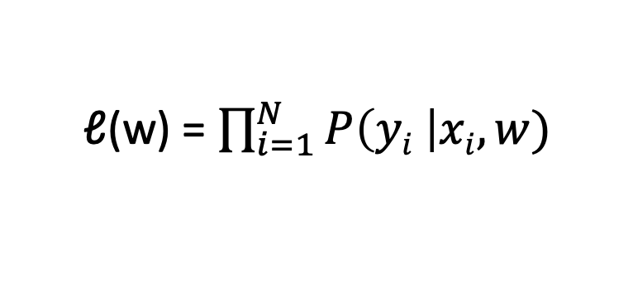
Quality metric: data likelihood
Data point | #awesome | #awful | y | Choose w to maximize
x₁ | 3 | 0 | +1 | P(y=+1 | x₁, w)
x₂ | 1 | 5 | -1 | P(y=-1 | x₁, w)
…
x_{i} | xi[1] | xi[2] | y_{i} | P(yi | xi, w)
ℓ(w) = P(y₁ | x₁, w) * P(y₂ | x₂, w) * … * P(y_{i} | x_{i}, w)
ℓ(w) = $\prod_{i=1}^{N}{P\left(yi \right|xi, w)}$
Notes:
So when I learn a classifier, I'm given a set of input data.
So these are sentences that have been marked to say positive or negative sentiment, and as in regression, we split it into a training set and a test set.
I feed the training set to the classifier I'm trying to learn and that algorithm is actually going to learn the weights for words.
So for example it's going to learn that good has a weight 1.0. Awesome, 1.7 Bad, -1.0. And awful, -3.3.
And then, these weights are going to be used to score every element in
the test set and evaluate how good we're doing in terms of classification.
So lets talk about what that evaluation looks like.

Slide 31
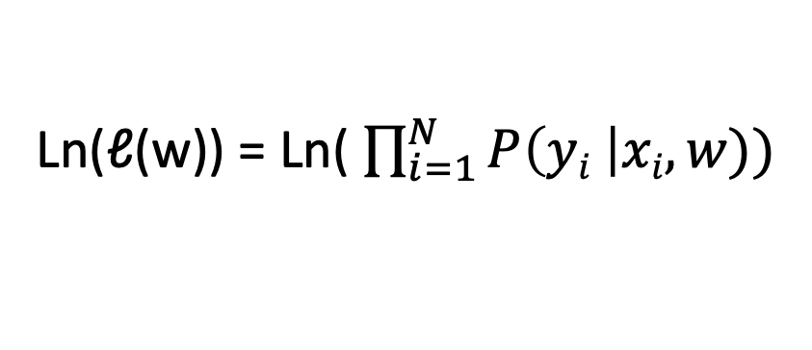
Maximizing likelihood
Plot likelihood
- > week 2 finding best linear classifier with gradient ascent
Ln(ℓ(w)) = Ln( $\prod_{i=1}^{N}{P\left(yi \right|xi, w))}$
The maxima of the function can be found using the gradient ascent algorithm
Notes:
So when I learn a classifier, I'm given a set of input data.
So these are sentences that have been marked to say positive or negative sentiment, and as in regression, we split it into a training set and a test set.
I feed the training set to the classifier I'm trying to learn and that algorithm is actually going to learn the weights for words.
So for example it's going to learn that good has a weight 1.0. Awesome, 1.7 Bad, -1.0. And awful, -3.3.
And then, these weights are going to be used to score every element in
the test set and evaluate how good we're doing in terms of classification.
So lets talk about what that evaluation looks like.

Slide 32
Machine learning and classification
Training dataset
x
Feature extraction
h (x)
ML model
^
y
Predicted class
review
sentence
words
P(y=+1 |x,w)
w
Word weights
ML algorithm
Gradient ascent
y
review
sentiment
Quality metric
Data likelihood
Sprint 1 - Regression

Slide 33
Concepts: Evaluating a classifier
Sprint 3 - Retrieval

Slide 34
Linear Classifier
word | weight
awesome | 2.85
great | 1.7
characters | 0
bad | -1.5
Learning model
Training set
Data
Accuracy
Validation set
Good reviews
Bad reviews
How do we evaluate a model?
Notes:
So when I learn a classifier, I'm given a set of input data.
So these are sentences that have been marked to say positive or negative sentiment, and as in regression, we split it into a training set and a test set.
I feed the training set to the classifier I'm trying to learn and that algorithm is actually going to learn the weights for words.
So for example it's going to learn that good has a weight 1.0. Awesome, 1.7 Bad, -1.0. And awful, -3.3.
And then, these weights are going to be used to score every element in
the test set and evaluate how good we're doing in terms of classification.
So lets talk about what that evaluation looks like.

Slide 35
Classification error & accuracy
Model
Y = +1
Prediction correct
X1 =“The book and this edition are awesome!”
Y1 = +1
Hide label
Model
Y = +1
Prediction error
X2 = “The book was OK.”
Y2 = -1
Hide label
Notes:
So when I learn a classifier, I'm given a set of input data.
So these are sentences that have been marked to say positive or negative sentiment, and as in regression, we split it into a training set and a test set.
I feed the training set to the classifier I'm trying to learn and that algorithm is actually going to learn the weights for words.
So for example it's going to learn that good has a weight 1.0. Awesome, 1.7 Bad, -1.0. And awful, -3.3.
And then, these weights are going to be used to score every element in
the test set and evaluate how good we're doing in terms of classification.
So lets talk about what that evaluation looks like.

Slide 36
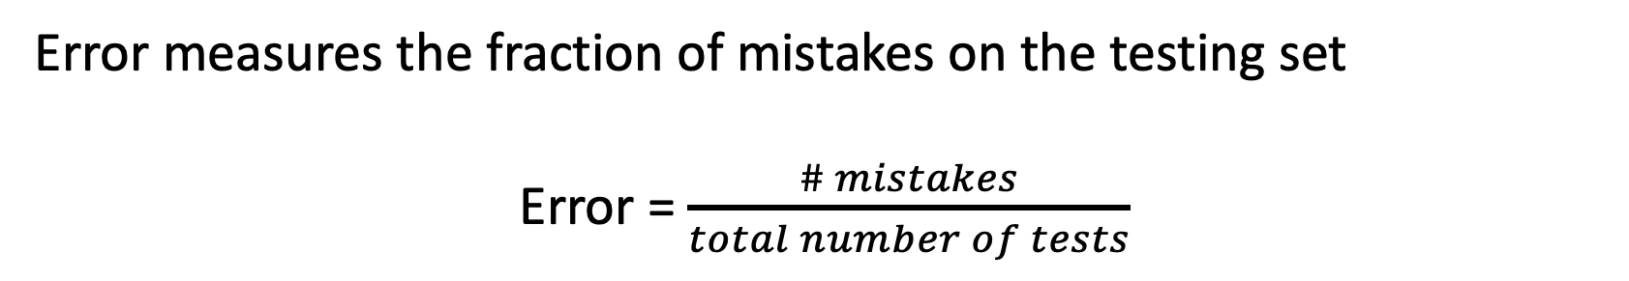
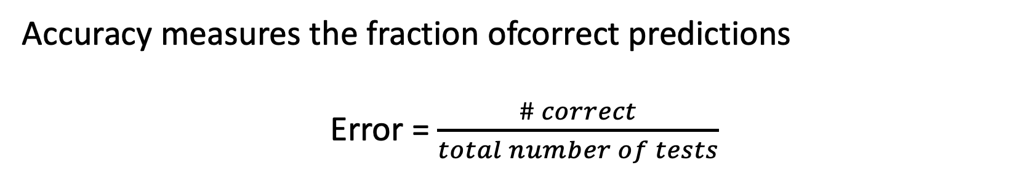
Classification error & accuracy
Error measures the fraction of mistakes on the testing set
Error = $\frac{\# mistakes}{total number of tests}$
We want it as close as 0 as possible
Accuracy measures the fraction ofcorrect predictions
Error = $\frac{\# correct}{total number of tests}$
We want it as close as 1 as possible
Notes:
So when I learn a classifier, I'm given a set of input data.
So these are sentences that have been marked to say positive or negative sentiment, and as in regression, we split it into a training set and a test set.
I feed the training set to the classifier I'm trying to learn and that algorithm is actually going to learn the weights for words.
So for example it's going to learn that good has a weight 1.0. Awesome, 1.7 Bad, -1.0. And awful, -3.3.
And then, these weights are going to be used to score every element in
the test set and evaluate how good we're doing in terms of classification.
So lets talk about what that evaluation looks like.

Slide 37
Introduction : Evaluating a logistic classifier
Predicted as viral when p(x) > 0.5
Recall (True positive rate) : How many viruses did I retrieve ?
False Positive rate : How many prokaryotes were identified as viruses ?
Precision : How many selected items are viruses ?
Notes:
Let's discuss how we measure error, in fact, classification error, when we're doing this classification.

Slide 38
Introduction : Evaluating a logistic classifier
Predicted as viral when p(x) > 0.5
Recall (True positive rate) : How many viruses did I retrieve ?
R=20/25
False Positive rate : How many prokaryotes were identified as viruses ?
Precision : How many selected items are viruses ?
Notes:
https://www.coursera.org/learn/ml-foundations/lecture/PwEPC/training-and-evaluating-a-classifier

Slide 39
Introduction : Evaluating a logistic classifier
Predicted as viral when p(x) > 0.5
Recall (True positive rate) : How many viruses did I retrieve ?
R=20/25
False Positive rate : How many prokaryotes were identified as viruses ?
FPR=3/25
Precision : How many selected items are viruses ?
Notes:
https://www.coursera.org/learn/ml-foundations/lecture/PwEPC/training-and-evaluating-a-classifier

Slide 40
Introduction : Evaluating a logistic classifier
Predicted as viral when p(x) > 0.5
Recall (True positive rate) : How many viruses did I retrieve ?
R=20/25
False Positive rate : How many prokaryotes were identified as viruses ?
FPR=3/25
Precision : How many selected items are viruses ?
P=20/23
Notes:
https://www.coursera.org/learn/ml-foundations/lecture/PwEPC/training-and-evaluating-a-classifier

Slide 41
Concepts:Overfitting Classifiers and regularization
Sprint 3 - Retrieval

Slide 42
Learning a decision boundary
Feature | Value | Coefficient
h₀(x) | 1 | 0.23
h₁(x) | X[1] | 1.12
h₂(x) | X[2] | -1.07
X[2]
X[2]
X[1]
X[1]
Sprint 1 - Regression

Slide 43
Learning a decision boundary
Feature | Value | Coefficient
h₀(x) | 1 | 21.6
h₁(x) | X[1] | 5.3
h₂(x) | X[2] | -42.7
h₃(x) | X[1]² | -15.9
h₄(x) | X[1]² | 67.0
h₅(x) | X[1]³ | 48.0
h₆(x) | X[1]³ | 0.8
h₇(x) | X[1]⁴ | -14.2
h₈(x) | X[1]⁴ | -8.8
X[2]
X[2]
X[1]
X[1]
Sprint 1 - Regression

Slide 44
Learning a decision boundary
Feature | Value | Coefficient
h₀(x) | 1 | 21.6
h₁(x) | X[1] | 5.3
h₂(x) | X[2] | -42.7
h₃(x) | X[1]² | -15.9
h₄(x) | X[1]² | 67.0
h₅(x) | X[1]³ | 48.0
h₆(x) | X[1]³ | 0.8
h₇(x) | X[1]⁴ | -14.2
h₈(x) | X[1]⁴ | -8.8
X[2]
X[2]
X[1]
X[1]
Very often, overfitting is associated with very large estimated coefficients w
Sprint 1 - Regression

Slide 45
Overfitting
Test error
Overfitting if:
There exist a model with estimated parameters w’ such that:
Training error (w) < training error (w’)
Test error (w) > test error (w’)
Error
Training error
Model complexity
Sprint 1 - Regression

Slide 46
Overfitting
In Logistic regression, overfitting leads to over confident predictions
Score(X_{i}) = W₀ + w₁ x_{i}[1] + … + w_{d} x_{i}[d]
-∞ < Scores < +∞
-∞
0
+∞
Y_{i} = -1
Y_{i} = +1
P(y=+1 |x_{i}, w) = sigmoid(Score(X_{i}))
0 < Proba < 1
0
1
0.5
Sprint 1 - Regression

Slide 47
Interpreting Score(X_{i})
Score(X_{i}) = W₀ + w₁ x_{i}[1] + … + w_{d} x_{i}[d]
-∞ < Scores < +∞
-∞
0
+∞
Y_{i} = -1
Y_{i} = +1
How do we link ?
Very sure !
Not sure !
Very sure !
P(y=+1|x_{i}) = 0
P(y=+1|x_{i}) = 0.5
P(y=+1|x_{i}) = 1
0 < Proba < 1
Notes:
So when I learn a classifier, I'm given a set of input data.
So these are sentences that have been marked to say positive or negative sentiment, and as in regression, we split it into a training set and a test set.
I feed the training set to the classifier I'm trying to learn and that algorithm is actually going to learn the weights for words.
So for example it's going to learn that good has a weight 1.0. Awesome, 1.7 Bad, -1.0. And awful, -3.3.
And then, these weights are going to be used to score every element in
the test set and evaluate how good we're doing in terms of classification.
So lets talk about what that evaluation looks like.

Slide 48
Concepts: L2 regularization
Sprint 3 - Retrieval

Slide 49
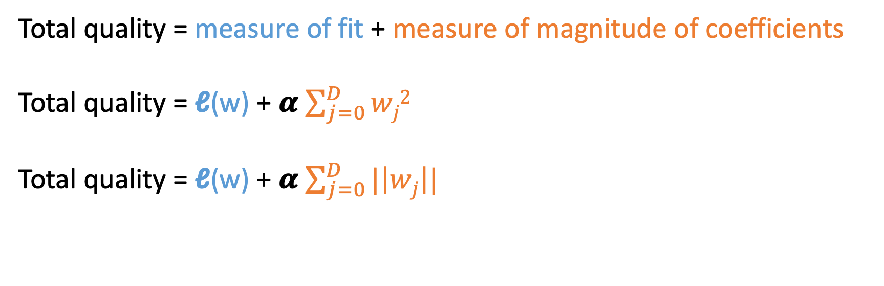
Desired total cost
We want to balance:
How well function fits the training data
The magnitude of coefficients
Total quality = measure of fit + measure of magnitude of coefficients
Total quality = ℓ(w) + 𝜶 $\sum_{j=0}^{D}{wj2}$
Total quality = ℓ(w) + 𝜶 $\sum_{j=0}^{D}{|\left|wj\right||}$
L2 norm
L1 norm
Both penalize large coefficients, but L1 norm also provides a sparse solution
Notes:
So when I learn a classifier, I'm given a set of input data.
So these are sentences that have been marked to say positive or negative sentiment, and as in regression, we split it into a training set and a test set.
I feed the training set to the classifier I'm trying to learn and that algorithm is actually going to learn the weights for words.
So for example it's going to learn that good has a weight 1.0. Awesome, 1.7 Bad, -1.0. And awful, -3.3.
And then, these weights are going to be used to score every element in
the test set and evaluate how good we're doing in terms of classification.
So lets talk about what that evaluation looks like.

Slide 50
Implementation: Sentiment analysis using logistic regression
Sprint 3 - Retrieval

Slide 51
Book reviews sentiment analysis
Positive review
Review 1:
The story was amazing, the characters well developed and plot thrilling.
Classifier
Negative review
Sprint 2 - Classification

Slide 52
Concepts:Training biases
Sprint 3 - Retrieval

Slide 53

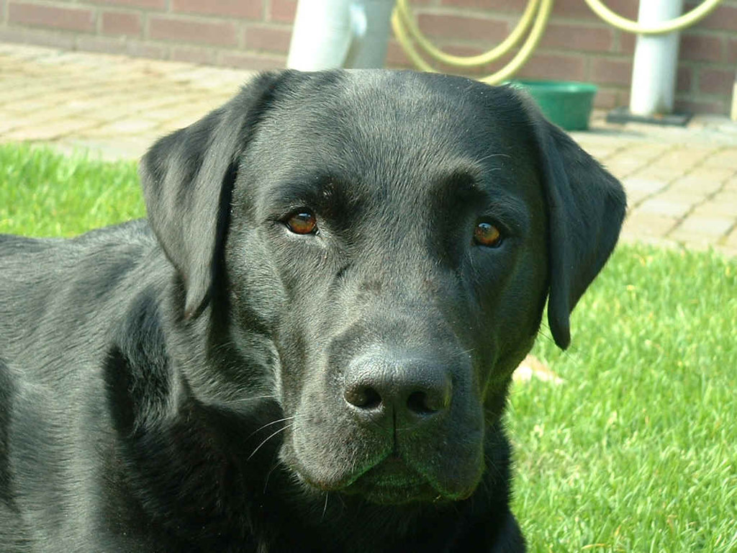



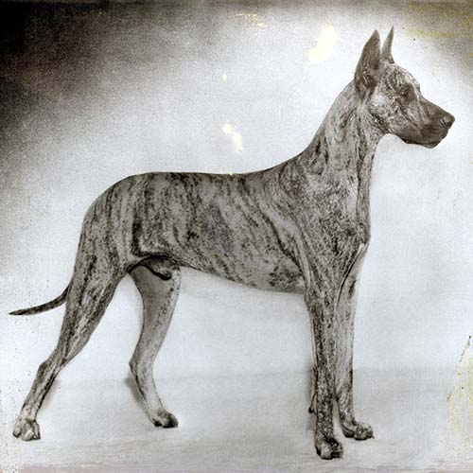

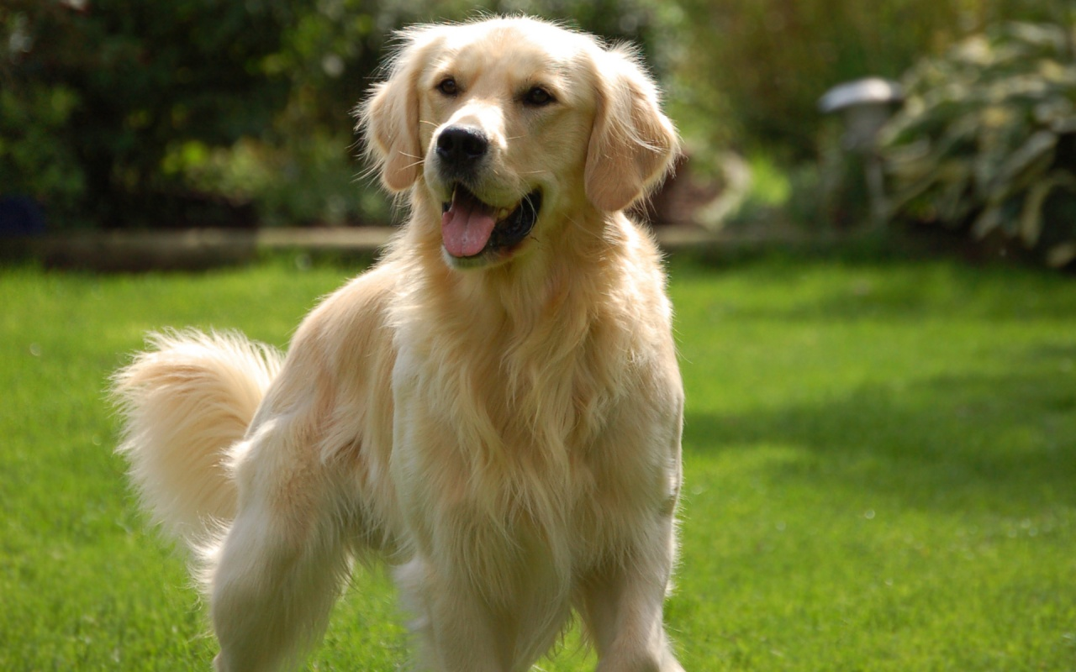
Training set composition matters
Sample bias arises when the training set doesn’t fully encompass the true variability of your object.
Training set
VirFinder’s training set : phage and prokaryotes genomes for training
What are the consequences of an eukaryotic contamination ?
Notes:
https://www.coursera.org/learn/ml-foundations/lecture/PwEPC/training-and-evaluating-a-classifier

Slide 54
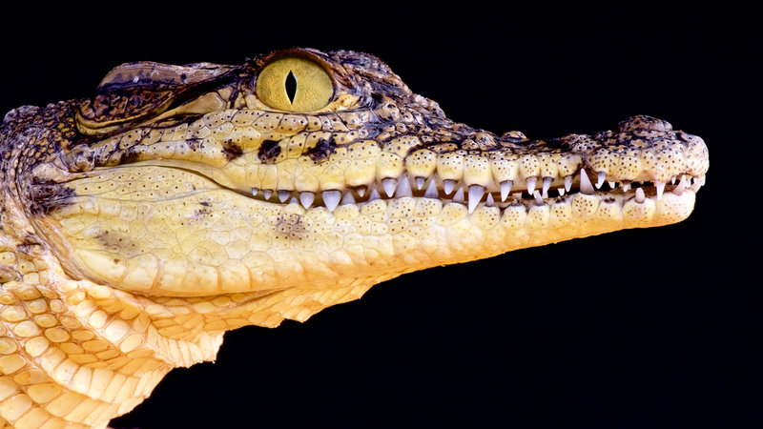
Training set composition matters
Sample bias arises when the training set doesn’t fully encompass the true variability of your object.
Training set
?
VirFinder’s training set : phage and prokaryotes genomes for training
What are the consequences of an eukaryotic contamination ?
Notes:
https://www.coursera.org/learn/ml-foundations/lecture/PwEPC/training-and-evaluating-a-classifier

Slide 55
Training set composition matters
Prejudice bias arises when the training set has some inherent biases. The model will not only learn those biases but will end up amplifying them.
Training set
VirFinder’s training set : RefSeq complete genomes published before 2014
What is the effect of the training composition on the tool’s performance on various viral groups ?
Notes:
https://www.coursera.org/learn/ml-foundations/lecture/PwEPC/training-and-evaluating-a-classifier

Slide 56

Training set composition matters
Prejudice bias arises when the training set has some inherent biases. The model will not only learn those biases but will end up amplifying them.
Training set
?
VirFinder’s training set : RefSeq complete genomes published before 2014
What is the effect of the training composition on the tool’s performance on various viral groups ?
Notes:
https://www.coursera.org/learn/ml-foundations/lecture/PwEPC/training-and-evaluating-a-classifier

Slide 57
Concepts:The problem of rare events detection
Sprint 3 - Retrieval

Slide 58
Low event detection
The detection of low events is a difficult issue, leading to a drop in precision.
Model A :
TPR= 0.9
FPR= 0.1
50% : 50 viral seq + 50 prokaryotic seq
True Positives = 45
False Positives = 5
Precision= 45/50=0.9
10% : 10 viral seq + 90 prokaryotic seq
Notes:
https://www.coursera.org/learn/ml-foundations/lecture/PwEPC/training-and-evaluating-a-classifier

Slide 59
Low event detection
The detection of low events is a difficult issue, leading to a drop in precision.
Model A :
TPR= 0.9
FPR= 0.1
50% : 50 viral seq + 50 prokaryotic seq
True Positives = 45
False Positives = 5
Precision= 45/50=0.9
10% : 10 viral seq + 90 prokaryotic seq
True Positives = 9
False Positives = 9
Precision=9/18=0.5
Notes:
https://www.coursera.org/learn/ml-foundations/lecture/PwEPC/training-and-evaluating-a-classifier

